Slide 1
Biniog Sathi
A New Generation Banking Model
6th Global Islamic Microfinance Forum
Nairobi, Kenya
8-9 November 2016

Slide 2
What is “Biniog Sathi”?
“Biniog Sathi” is a new generation banking model that solves the default problem.
“Biniog Sathi” is a Bangla word. It means “Friend in Investment”. A true friend can never let the life of his friend to ruin if he goes into trouble. We believe that a true financing institution should stand beside its borrowers in both good and bad times. This is the main essence of this model.

Slide 3
The Problem of Default
The problem of default is common in all the present banking models, i.e., both Conventional and Islamic
Although default rate is low for Microfinance Institutions, but it achieves this at the cost of beneficiary’s reducing their standard of living
High risk of default is inducing MFIs to leave ultra-poor section of the society
Under present banking system, a true defaulter loses everything to the Bank whenever he defaults on his debt

Slide 4
Features of Biniog Sathi
The model incorporates Zakat and Charity with the present banking model.
The model is based on Islamic Banking Principles and it makes Islamic banking more competitive
It offers a solution to the Problem of Credit Default for the clients and the MFIs.
This model is a blessing particularly for Microfinance beneficiaries
The model unleashes the power of Zakat and Charity

Slide 5
Zakat Distribution
Poor people
Needy people
Zakat Collectors
Whose hearts are to be won over
Captives needed to be free
Debt Defaulters
For the cause of Allah
Distressed travelers
Muslims now a days concentrate on poor and needy people only for the utilization of their Zakat. The other six categories of people are largely ignored

Slide 6
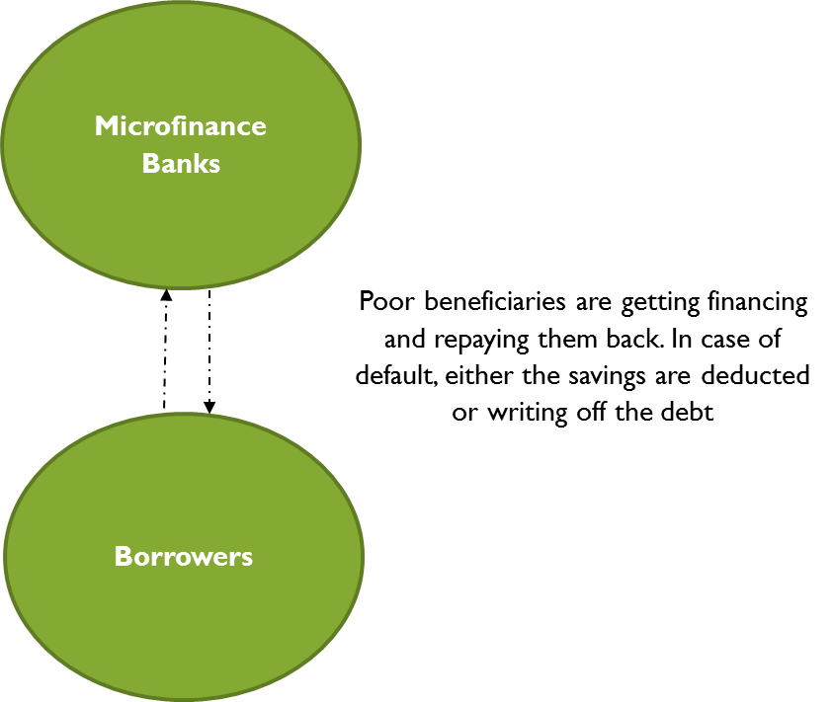
Present MFI Model

Slide 7
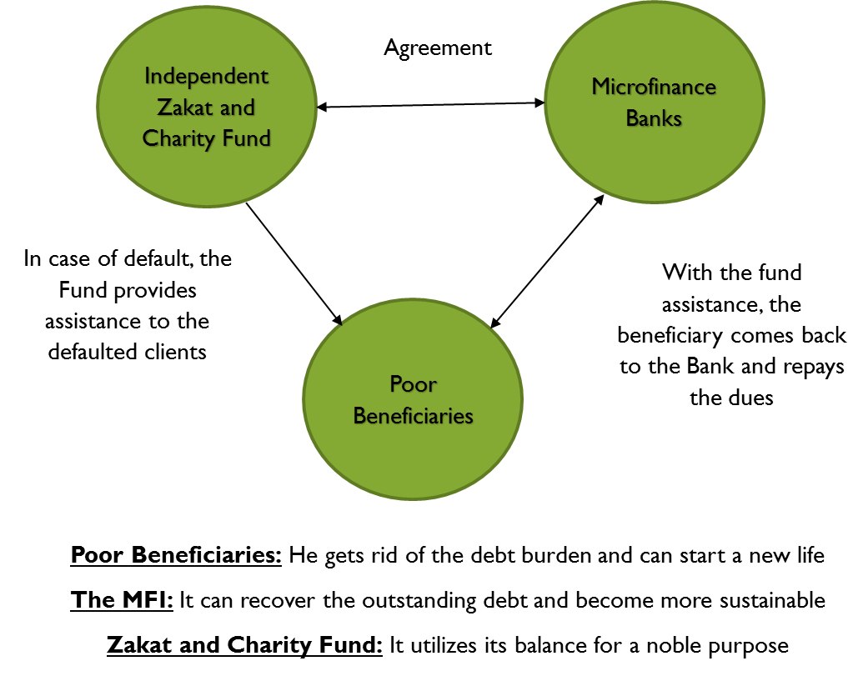
Biniog Sathi Model

Slide 8
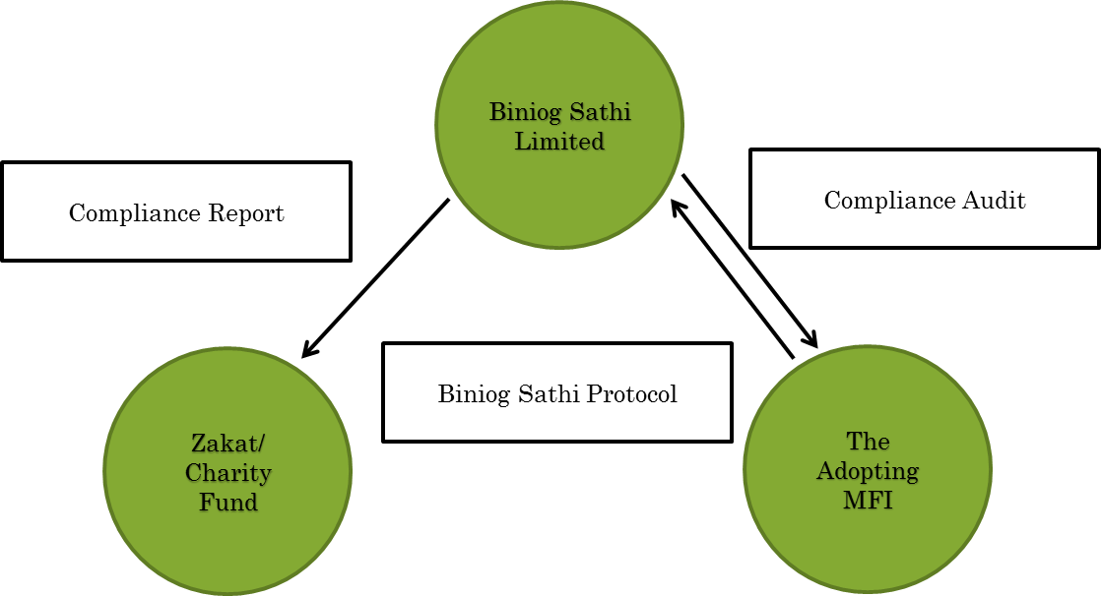
Addressing Moral Hazard
Yearly Compliance Audit will check whether the MFI has followed Biniog Sathi Protocol before issuing the Certificate to the defaulted borrowers

Slide 9
Development Impact
This model is a blessing for Islamic Micro Finance Institutions (I-MFIs) and micro clients
The model will provide incentives to the poor beneficiaries to continue their productive activities without any fear of being in default
This model will help Islamic MFIs to reach the ultra-poor section, which is a challenge due to increased cost
The model will help Zakat and Charity Funds to be connected with the real economy
Due to the positive impact on the poor beneficiaries, Donors will tend to pay more Zakat and Charity
Joint effort between I-MFIs and Zakat and Charity Funds will accelerate poverty reduction

Slide 10
Testing of the Model
The model is now an Official ICD Initiative. It received an award from ICD in 2016
ICD is now entering into MOUs with AlHuda CIBE and Akhuwat to test the model at the field level in Pakistan. The proposed testing period is 2 years
ICD is also in the process of entering into MOUs with the City Bank and Coders Trust to test the model in Bangladesh
ICD is in the process of forming its own Zakat and Charity Fund with the help of donations from its staff. Every year, ICD staffs donate Zakat and Charity on various occasions. This Fund will help raise Zakat and Charity during the testing phase
In future, formal relationship will be formed with established Zakat and Charity Funds to run the model sustainably

Slide 11
Testing Indicators
Indicator 1: Is the default rate of clients increasing than before? (Yes/No)
Indicator 2: Do Zakat recipients tend to ask for Zakat on a continuous basis? (Yes/No)
Indicator 3: Is there remarkable change in risk taking behavior amongst beneficiaries when learnt about the Zakat assistance? (Yes/No)
Indicator 4: The jobs in the MFI become for enjoyable? (Yes/No)
Indicator 5: The MFI becomes more sustainable in the future? (Yes/No)

Slide 12
Thank You
Biniog Sathi is a registered Trademark. All rights reserved. Any unauthorized use and replication of the model is prohibited.

